Slide 1


Painting 3D Nature in 2D: View Synthesis of Natural
Scenes from a Single Semantic Mask
Shangzhan Zhang¹, Sida Peng¹, Tianrun Chen¹, Linzhan Mou¹, Haotong Lin¹,
Kaicheng Yu², Yiyi Liao¹, Xiaowei Zhou¹
Zhejiang University¹, Alibaba Group²
Notes:
We present a novel framework, Painting 3D Nature in 2D, which can optimize neural fields for view synthesis of natural scenes using only a single semantic map as input.

Slide 2
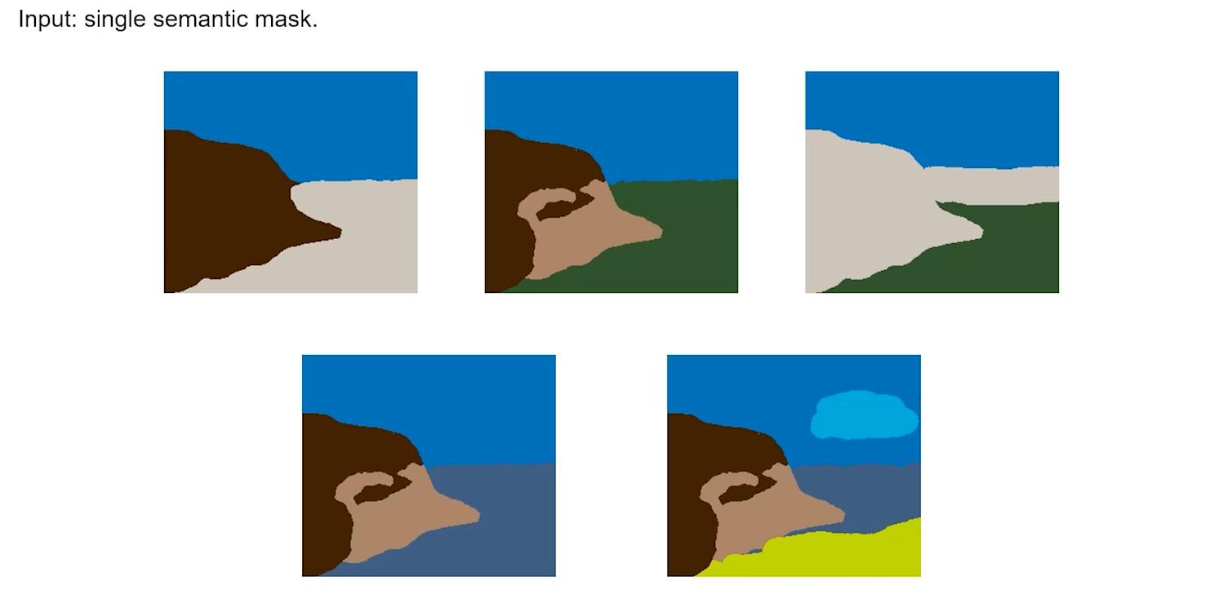
Problem Background
Notes:
This work focuses on a specific setting of synthesizing novel views of natural scenes given a single semantic mask, which enables us to generate 3D contents by editing 2D semantic masks.

Slide 3
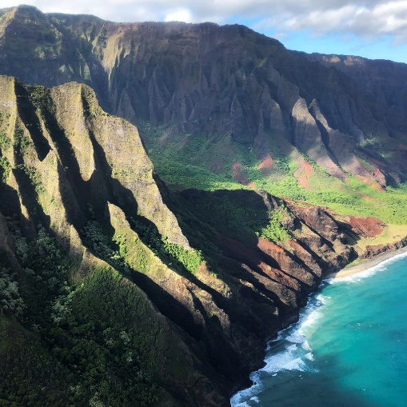

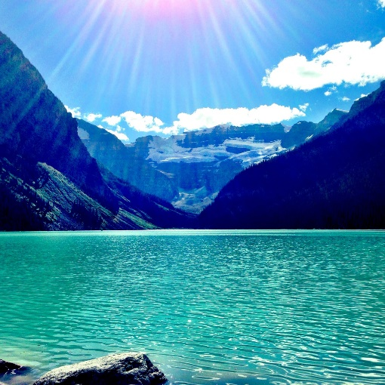
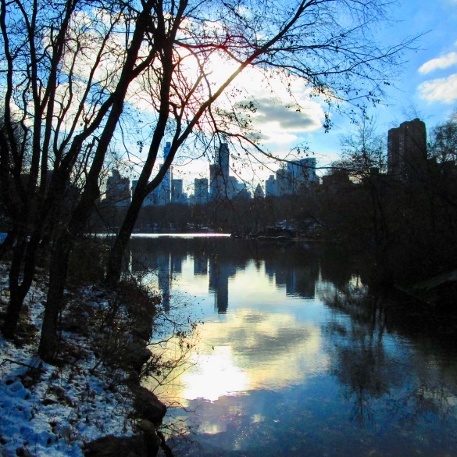

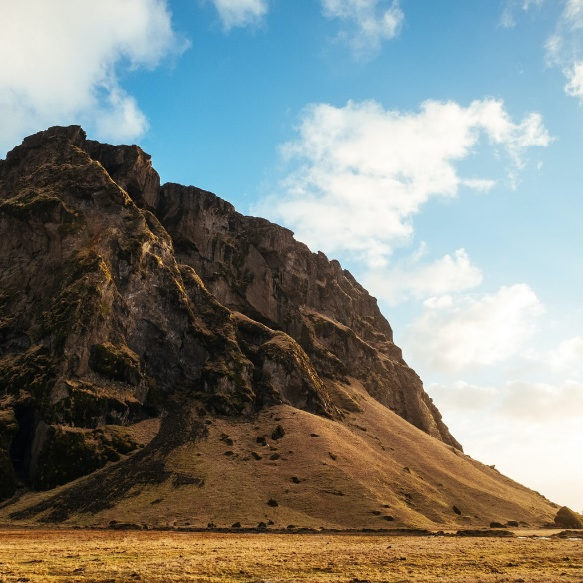
Problem Background
What makes natural scene so interesting?
Natural scenes are indispensable content
It is difficult to collect 3D data or posed videos of natural scenes.
There are abundant single-image landscape datasets.
[1] Aligning Latent and Image Spaces to Connect the Unconnectable, ICCV 2020
Notes:
Natural scenes are indispensable content in many applications such as film production and video games. Compared to urban or indoor scenes, it is difficult to collect 3D data or posed videos of natural scenes for training, the similar problem is also discussed in Infinite Nature zero.
However, there are abundant single-image landscape datasets that can be easily obtained online.

Slide 4
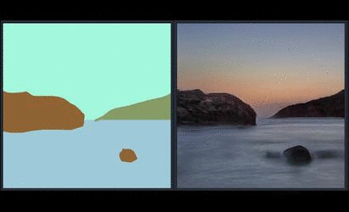
Related Work: SPADE
SPADE can convert a single semantic mask into a realistic RGB image.
Notes:
With the development of deep generative models, 2D semantic image synthesis methods have achieved impressive advances.

Slide 5
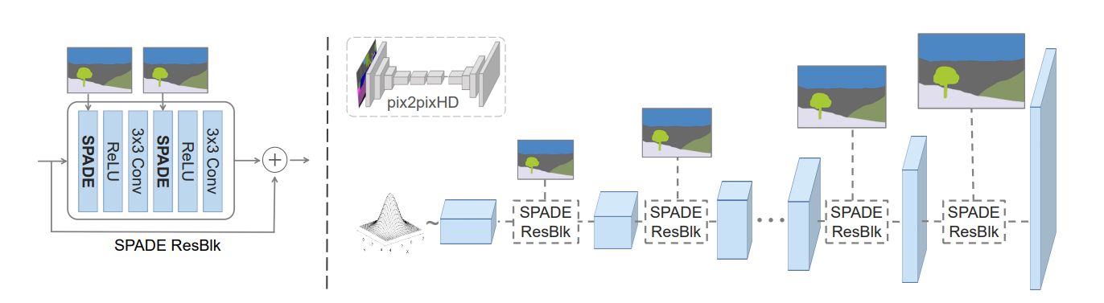
Related Work: SPADE
Limitation: Not 3D-aware, unable to perform novel view synthesis.
Notes:
However, they do not consider the underlying 3D world and cannot generate multi-view consistent free-viewpoint videos

Slide 6
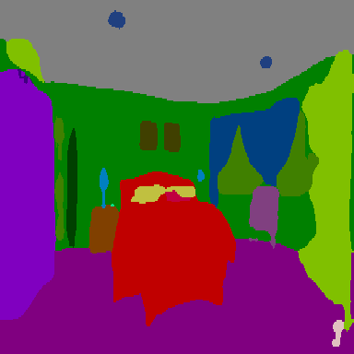
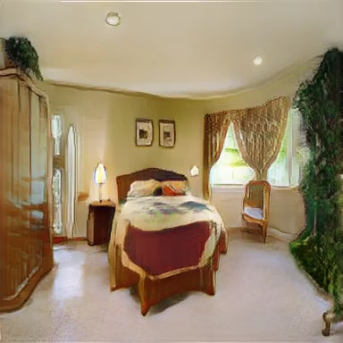
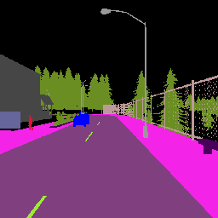
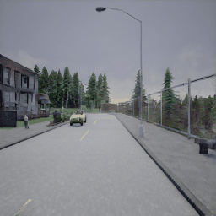
Related Work: GVS and SVS
SVS and GVS can predict the MPI from a semantic mask, enabling novel view synthesis.
[1] Generative View Synthesis: From Single-view Semantics to Novel-view Images, NeurIPS 2020
[2] Semantic View Synthesis, ECCV 2020
Notes:
By utilizing a single 2D semantic mask as input, SVS and GVS possess the ability to predict the Multiplane Image, enabling them to perform innovative view synthesis.

Slide 7
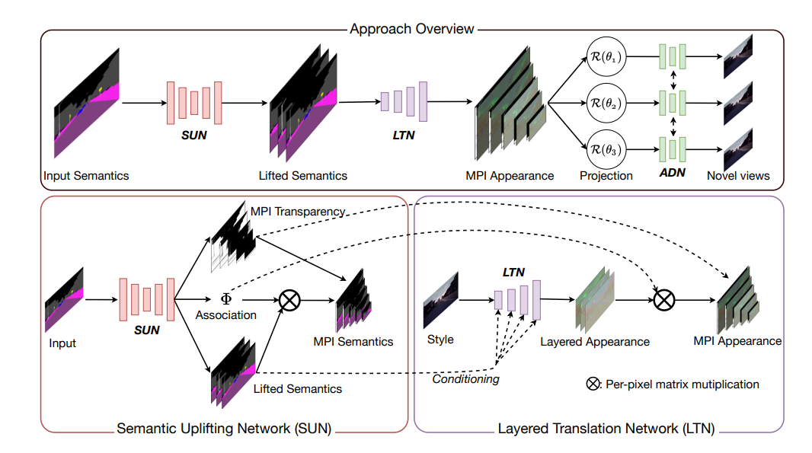
Related Work: GVS and SVS
Limitation: they require posed videos for training.
[1] Generative View Synthesis: From Single-view Semantics to Novel-view Images, NeurIPS 2020
[2] Semantic View Synthesis, ECCV 2020
Notes:
However, they train their models on datasets of posed videos. A problem with such a training strategy is that a large number of videos with calibrated camera poses are hard to obtain in real life, which could be expensive and limit the diversity of training data.

Slide 8
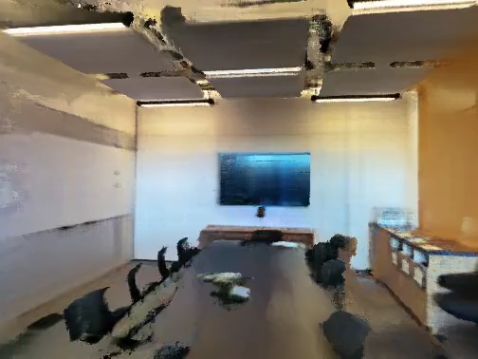
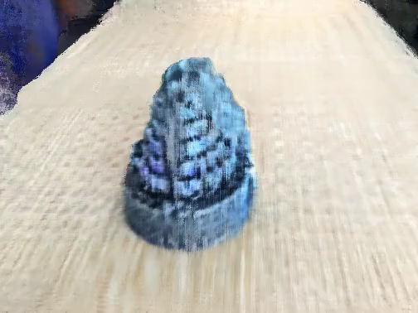
Challenges
How to train a neural field on a single semantic mask?
Train a neural field on a single RGB image is already challenging
[1] SinNeRF: Training Neural Radiance Fields on Complex Scenes from a Single Image, arXiv 2022
Notes:
Training neural fields directly on a single semantic map is a challenging task. This is because training neural fields typically necessitates multi-view RGB image data. The performance of SinNeRF exemplifies the challenges associated with training NeRF solely using a single RGBD image, let alone attempting to train a neural field using a single semantic mask.

Slide 9
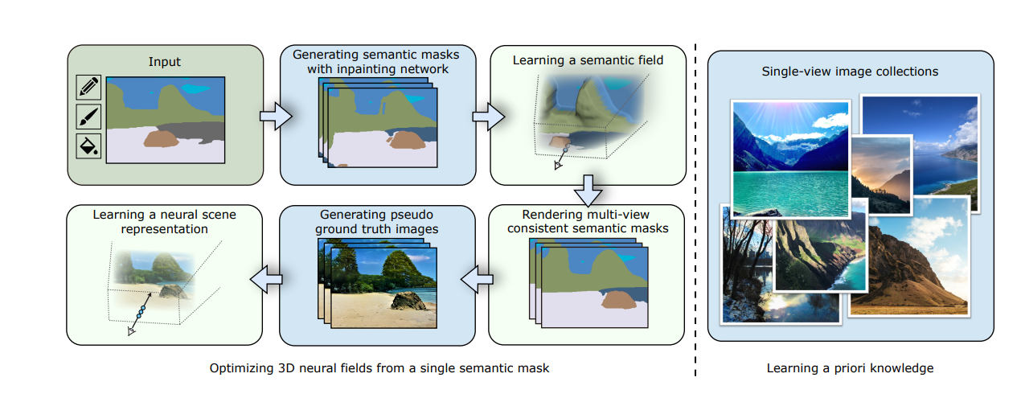
Methods
Divide this task into two simpler subproblems:
Single semantic mask -> Multi-view semantic masks (semantic inpainting network)
Multi-view semantic masks -> Multi-view RGB images (image-to-image translation)
Notes:
Based on the observation that semantic masks have much lower complexity than images, we exploratively divide this task into two simpler subproblems: we first generate semantic masks at novel views and then translate them to RGB images through SPADE. For view synthesis of semantic masks, the input semantic mask is first translated to a color image by SPADE, and a depth map is predicted from the color image by a depth estimator. Then the input semantic mask is warped to novel views using the predicted depth map and refined by an inpainting network.

Slide 10
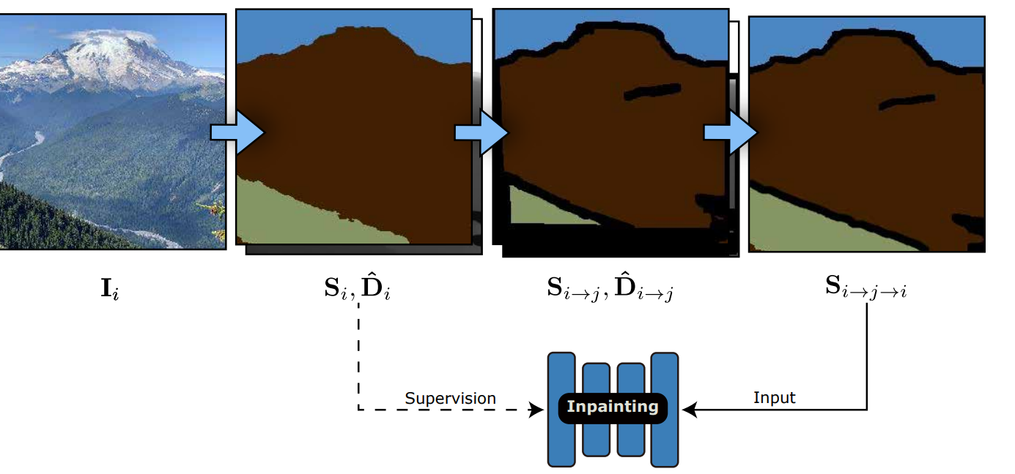
Methods
Our inpainting network is trained using a self-supervised method.
Notes:
Our inpainting network is trained using a self-supervised method. We produce a semantic mask and a depth map from a randomly sampled image , then warp them to a random novel view, and warp them back to the source view to generate semantic mask with holes. Our semantic inpainting network takes the semantic mask that have missing areas as input and is trained to recover the original semantic mask .

Slide 11
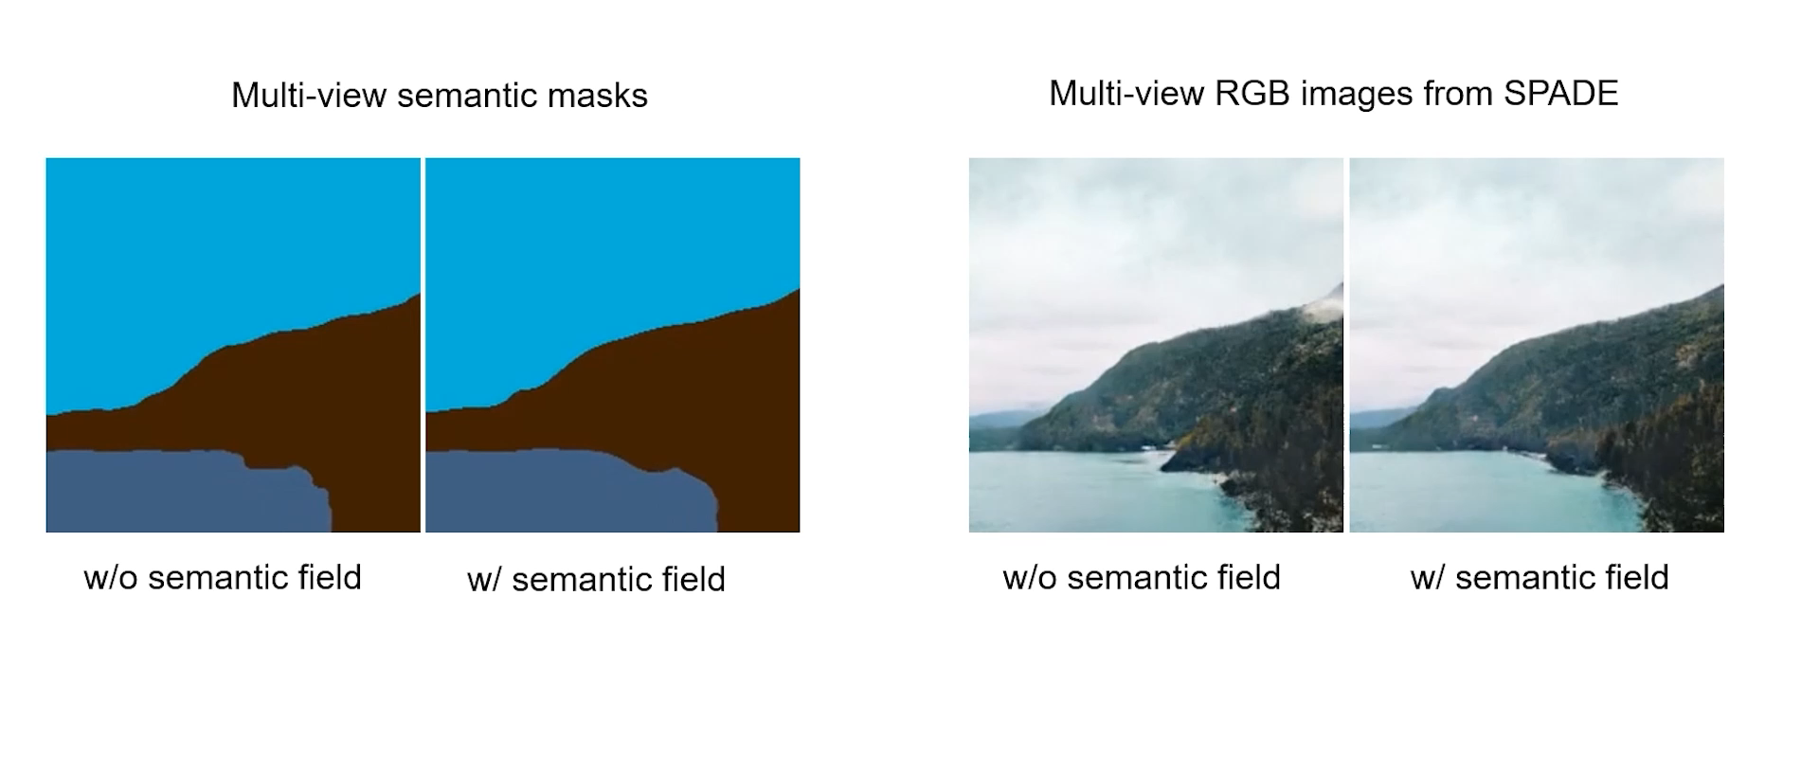
Methods
We learn a neural semantic field to fuse semantic masks for better view consistency.
Notes:
It is observed that semantic masks generated by the inpainting network tend to be view-inconsistent. As a result, SPADE could generate quite different contents in these regions even when the inconsistency is minor between the semantic masks. To solve this issue, we learn a neural semantic field to fuse and denoise these semantic masks for better multi-view consistency. Finally, we translate the multi-view semantic masks to color images by SPADE and reconstruct a neural scene representation for view-consistent rendering.

Slide 12
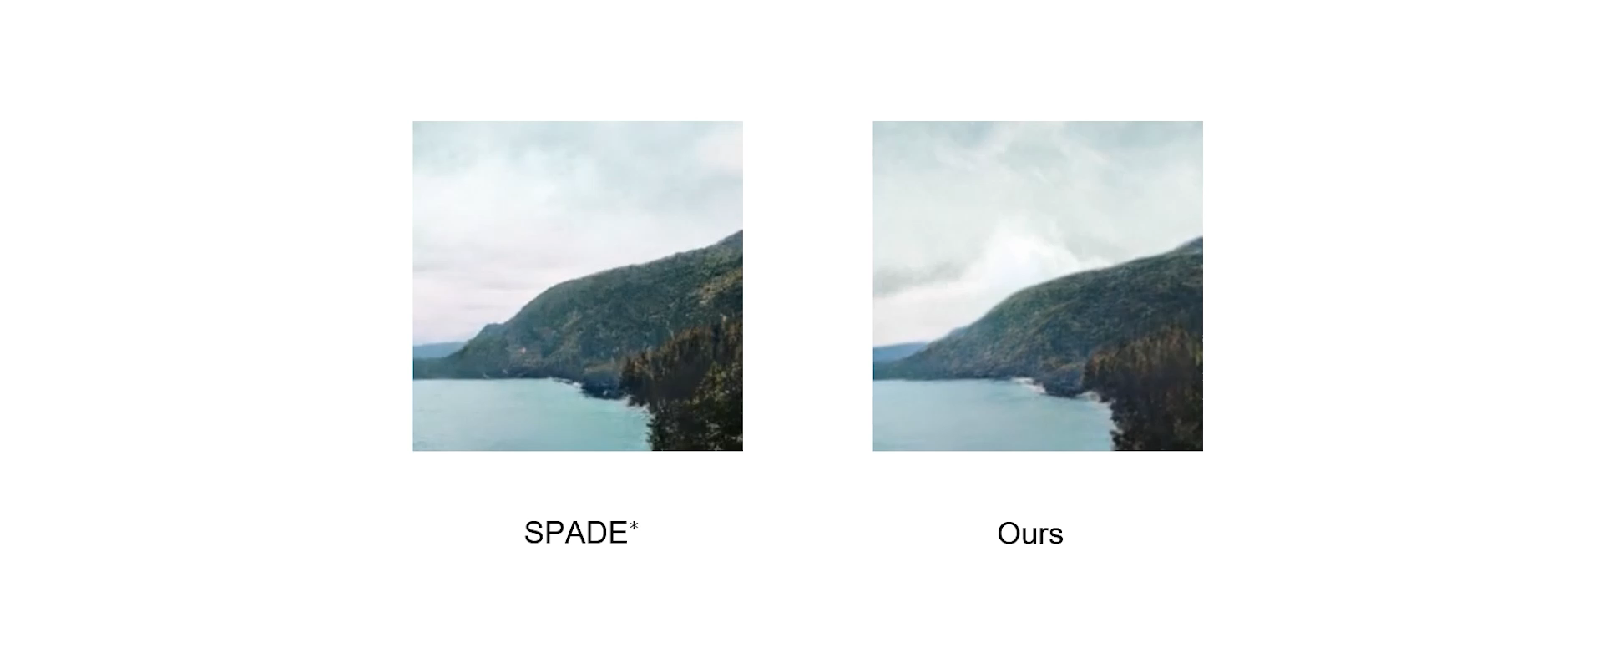
Methods
We fuse appearance information from SPADE by learning natural scene representations.
Notes:
Directly translating multi-view semantic masks to RGB images through SPADE fails to produce multi-view consistent rendering. To resolve this issue, we learn a natural scene representation to fuse appearance information provided by SPADE.

Slide 13
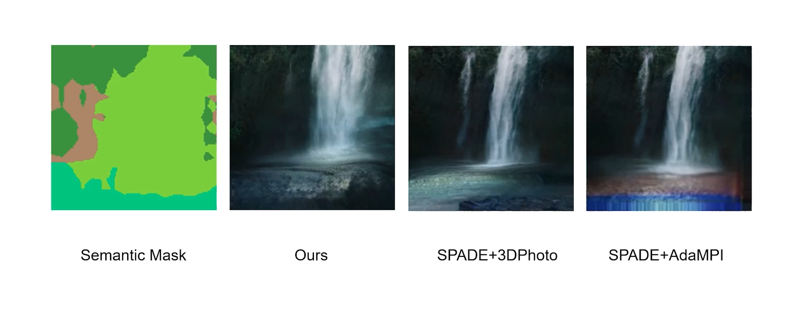
Comparisons
We produce more realistic results compared to all baselines
Notes:
Our method produces more realistic results compared to all baselines.

